Slide 1
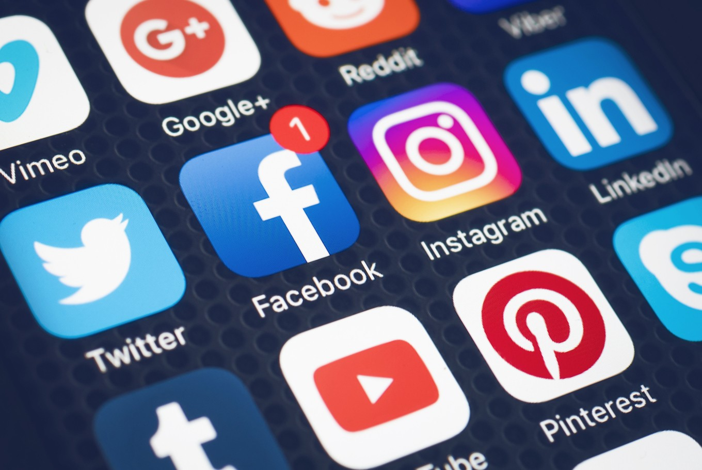
Social media Pros and Cons
Student
University

Slide 2
Pros of social media
1. It increases voter participation and facilitates political change.
Leaders use the platforms to educate voters on the importance of elections.
Political candidates use social media to inform people about their agendas and intended development projects.
Creating awareness of political affairs is made easier with the use of social media.
Some political analysts use social media for opinion polls.
When the majority of social media users are influenced positively in voting processes, they make a change in politics.

Slide 3

2. Social media reduces loneliness
ome people who are socially isolated like the old can access entertaining materials on social media.
People who lack time to socialize physically can make new friends and plan for meetings through Facebook and Instagram.
Some people prefer to stay indoors and interact with their friends through social media on their off days (Hao & Gao, 2017).
Stressed people are able to interact new friends and share experiences, which is a way of reducing depression cases.

Slide 4
3. Source of empowerment
Leaders can use the platforms to learn the interests and opinions of individuals.
Mentors are recently using ways like creating Facebook pages to inspire and motivate people on particular topics.
Women and youths can learn skills from each for financial growth and personal development.
Jobless individuals can easily access employment opportunities through websites shared in social media platforms.
LinkedIn is an example of a site where employers source for potential workers.

Slide 5
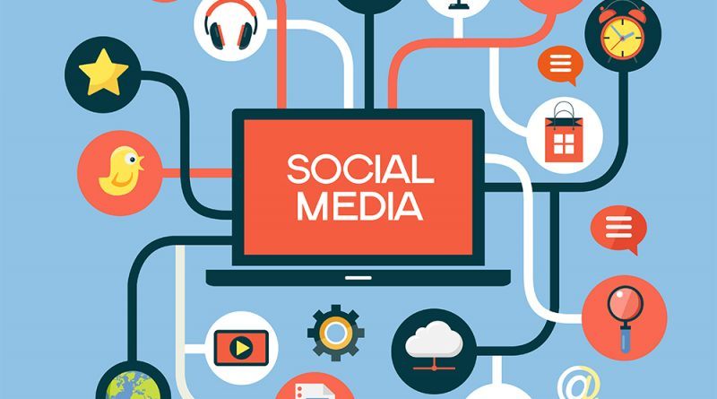
4. Provides academic research sources
.Students can access journals and articles posted on social media by some scholars.
Researchers efficiently conduct surveys on different platforms to gather evidence for specific research topics.
Recently, tutors and scholars have been using platforms like email accounts to upload educational materials.
Social media helps save original material for future reference.

Slide 6
Cons
1. Adverse effects on addicted students
Some students have neglected extra curricula activities to engage in unhelpful social media affairs.
Children who are addicted to the internet often forget to spare some time for academic revision.
Spending a lot of time on social media lead loss of attention for school going children.
Too much engagement in non-academic issues in the media affects the students’ performance negatively.

Slide 7
2. Increased crimes
Social media has recently contributed to the increased viewing of pornography for young people.
Young children are ready t access sex-related material from different platforms, which affects their behavior.
Criminals plan and practice criminal activities through social media.
People with bad motives download and use other people’s images to commit crimes.
Cybercrime has increased recently because social media makes it easy for the involved individuals in accessing people’s personal information.

Slide 8
3. Affecting the feelings of the users.
Some children develop anxiety and depression when they view traumatizing videos or read disturbing stories.
Most people lose self-esteem when they are bullied on social media or after comparing their lifestyles with others.
Individuals commit suicide after reading false stories.
Others develop certain different types of disorders like unhealthy eating following misleading advertisements and diets (Panahi et al., 2016, p98).
Some individuals disconnect from their family and friends due to addiction to social media.

Slide 9
4. Endangering lives of individuals
Some people access military information from social media with the aim of planning attacks.
The journalists are threatened when they post information that people have different views.
Activists are often bullied by people who do not agree with their opinions.
The information posted on social media cannot be deleted. Hence it puts people’s lives in danger due to the invasion of privacy.

Slide 10
References
Hao, J., & Gao, B. (2017). Advantages and disadvantages for nurses of using social media. of, 3, 2.
Panahi, S., Watson, J., & Partridge, H. (2016). Social media and physicians: exploring the benefits and challenges. Health informatics journal, 22(2), 99-112.
https://www.success.com/20-pros-and-cons-of-social-media-use/

